Slide 1
527 Data Analytics – Group 9
Executive Compensation Analysis & Review
Arjun Venkatesh - A20362158
Ganga Ravindra – A20345490
Sarin Vellore Ravi Shanker – A20349372
Sharan Prakash Babu – A20356488
Suman Kiran – A20353104
Notes:
Good Morning,
My group and I are going to presenting our analysis of Executive Compensation, text mining analysis of the Question and Answer section of the SEC filings and the KEI’s identified.
For our analysis we have chosen Electronic Arts as our company.
First I would like to brief you about the agenda for today’s presentation.

Slide 2
Table of Contents:
1 | Overview
2 | DEF 14A Filings – Electronic Arts Inc.
3 | Raw data extraction from R for Executive Compensation
4 | Analysis 1: Salary Trend (2006 – 2015)
5 | Analysis 2: Stock Awards (2006 – 2015)
6 | Analysis 3: Stock Trade Activity (2006 – 2015)
7 | Question & Answer Term Document Matrix Statistics
8 | Wordcloud
9 | Top 4 High Frequency Words
10 | Word Association
11 | Key Event Indicator (KEI)
12 | Conclusion
Notes:
We would first see a brief overview of the company.
Then move into the salary trend, stock option analysis of the CEO’s and also the stock trading activity of the organization.
Next we would cover the text mining analysis of the Question and Answer section, Wordcloud and KEIs identified.

Slide 3

Overview:
Industry Type : Video Games Interactive Entertainment
Electronic Arts Inc. is a leading global interactive entertainment software company. EA delivers games, content and Online services for Internet-connected consoles, personal computers, mobile phones and tablets.
Notes:
Electronic Arts, Inc. (EA), also known as EA Games, is an American developer, marketer, publisher and distributor of video games.
Founded in 1983 and Electronic Arts was the world's fourth-largest gaming company by revenue after Tencent, Sony and Microsoft.
EA has sales of close to 5 billion dollars and profits closed to 1 billion dollars for 2015 filing.

Slide 4
DEF 14A filings – Electronic Arts Inc.
YEAR URL FILING DATE
2015 http://www.sec.gov/Archives/edgar/data/712515/000119312515237104/d939178ddef14a.htm 6/26/2015
2014 http://www.sec.gov/Archives/edgar/data/712515/000119312514236264/d740192ddef14a.htm 6/13/2014
2013 http://www.sec.gov/Archives/edgar/data/712515/000119312513259589/d510167ddef14a.htm 6/14/2013
2012 http://www.sec.gov/Archives/edgar/data/712515/000119312512265133/d354736ddef14a.htm 6/8/2012
2011 http://www.sec.gov/Archives/edgar/data/712515/000119312511162968/ddef14a.htm 6/10/2011
2010 http://www.sec.gov/Archives/edgar/data/712515/000119312510142277/ddef14a.htm 6/18/2010
2009 http://www.sec.gov/Archives/edgar/data/712515/000119312509129576/ddef14a.htm 6/12/2009
2008 http://www.sec.gov/Archives/edgar/data/712515/000089161808000314/f40958dedef14a.htm 6/17/2008
2007 http://www.sec.gov/Archives/edgar/data/712515/000095013407013715/f30777dedef14a.htm 6/20/2007
2006 http://www.sec.gov/Archives/edgar/data/712515/000089161806000275/f21025dedef14a.htm 6/30/2006
Notes:
We have considered filings of ten years from 2006-2015 for our analysis.
The slide shows the links to the filings of each year and their respective filing dates.

Slide 5
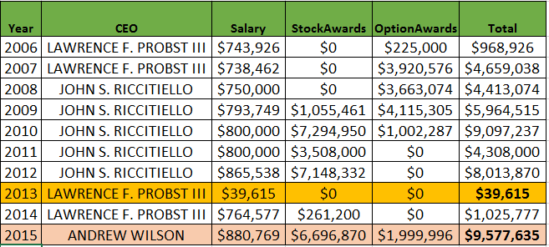
Raw data extraction from R for Executive Compensation
Table#: 1
Legend :
Highest Salary
Lowest Salary
Notes:
Slide presents the raw data of the executive compensation summary for the period 2006 -2015 obtained as an output from R.
Key observation that can be noted here is: For the year 2013, The CEO’s total compensation is the lowest whereas for 2015 it is being highest amongst the considered period.
Another interesting fact to be made note of; The CEO of the company has been changed 4 times within the past decade.

Slide 6
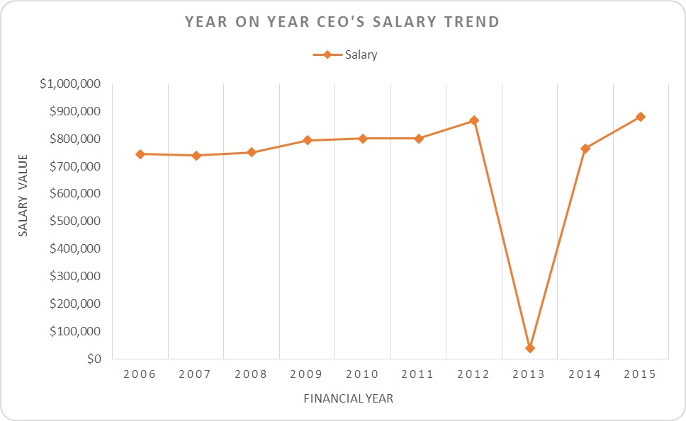
Analysis 1: SALARY TREND (2006 - 2015)
Chart#: 1
As seen from the chart, 2006 to 2011 is fairly steady with minimum rise and fall in salary amounts. Salary change ranges from $700,000 - $800,000.
Year 2012 has a slight change in Salary amount - $850,000.
Year 2013 has a massive drop with CEO receiving about $40,000 as salary.
However, year 2014 and 2015 has a rise up to $850,000.
Notes:
As observed from the previous slide, for the year 2013 CEO’s total compensation being the lowest. One of the key factors for it was, EA as a company by that point in time weren’t as innovative as they were considered before and also were facing a stiff competition from rival companies such as Activision, Rockstar and others.
Also the games that were being developed by EA, weren’t even close to being as good as their prequels.
In 2013, the CEO received a total compensation of mere $40,000 and in 2015 a huge sum of $9,580,000.

Slide 7
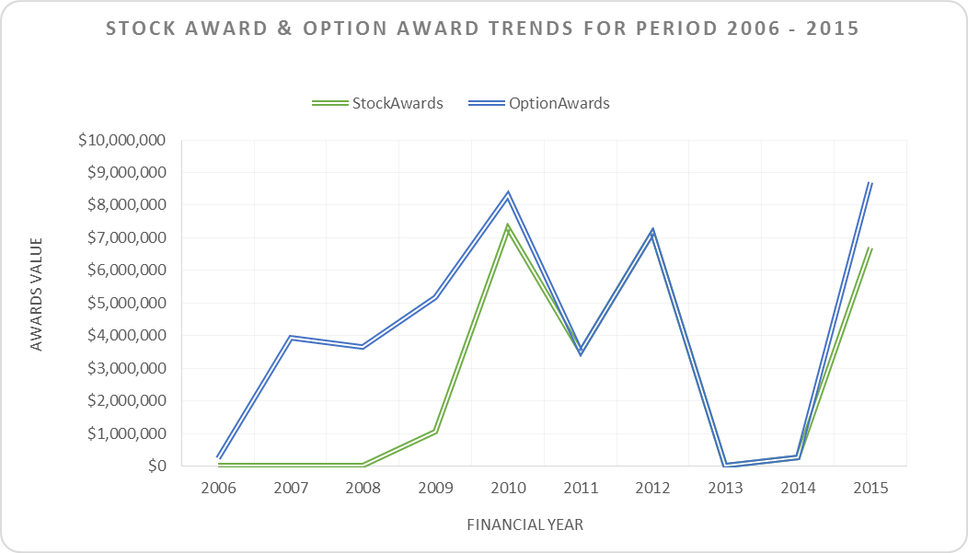
Analysis 2: STOCK AWARDS (2006 - 2015)
Chart#: 2
Considering the company's lack in movement towards internet games, saw a drop in their stock values as well. As a result, the CEO, LAWRENCE F. PROBST III received zero stock in the year 2006 and 2007.
2008 – 2010 saw increase in stock given to CEO, JOHN S. RICCITIELLO. Reason being he pushed the company towards internet gaming.
The company's resistance towards internet games put them in a dry state, losing stock value and customer popularity.
Notes:
Another important reason that led to EA’s epic fall in 2013 was the product marketing strategy they incorporated. EA started charging an extra fee for add on packs that were released for the existing games. This caused lot of its buyers to be disappointed with EA.
EA was also on an acquisition spree by this point, acquiring small time game developing companies such as Chillingo and PlayFish for colossal amount and there by emptying its cash reserve and this in turn resulted in layoffs of 1500 plus of its employees.
EA was also voted as the work to company to work for in America for 2013.

Slide 8
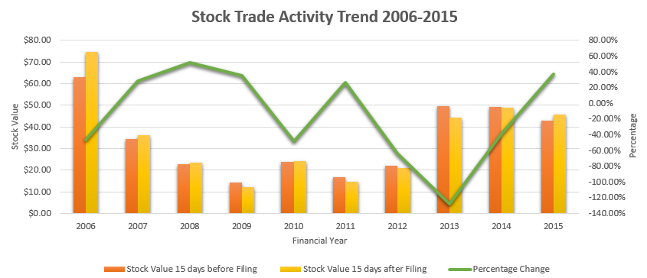
Analysis 3: STOCK TRADE ACTIVITY TREND (2006 – 2015)
Chart#: 3
The graph is a direct reflection of the above reasons
REASON - Could not compete with a new class of internet games such as Zynga and Rovi.
Evident from multiple stock variations - company which had grown into one of the world's largest video gaming companies since it was founded was now struggling.
Voted Worst Company was a wakeup call – re-thinking and re strategized policies, Access given to Beta version of their games – 1.3M users registered.
Profit has skyrocketed to $875 million from $8 million in 2014.
Notes:
With the above reasons that we highlighted, it is evident that because of the company's ways of working and their weak decisions, it had a great impact on its share value and stock trading activities. This is depicted in the above graph. The graph shows a significant drop in their trading activity for the year 2013.
In addition to the above reasons is another that the company could not compete with a new class of internet games and lost its market traction to competitors such as Zynga and Rovi which offered free games on smart phones and tablets.
The company which had grown into one of the world's largest video gaming companies since it was founded was now struggling.
However, being voted the worst company to work for in America served as a wakeup call. The company along with the CEO, its board and employees went back to re-thinking, re-strategizing its ways of working, adapted to new development models and worked towards making its operations better. They also introduced new survey events such as giving access to users of its beta version of games before release. This was a big hit. It gained 1.3M users registering for this event over a span of 12 days.
These changes saw a steep growth in their share value and stock trade in the year 2014 – 2015. Their profit skyrocketed from $8M to $875M in 2014.

Slide 9
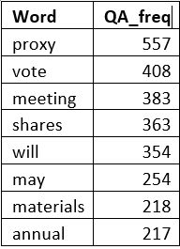
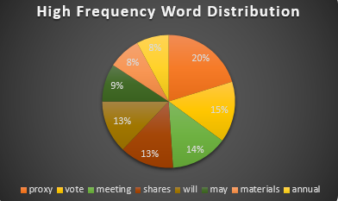
Question and Answer Term Document Matrix statistics - KEI
The chart depicts percentage wise breakup of words which are found most often in question and answer section of the filing document for Electronic Arts Inc.
Table#: 2 Chart#: 4
Notes:
Moving on to the next section of Text-Mining. We have incorporated the Question and Answer section of all the ten DEF 14A filings into one corpus. The automated code handles this and many other functionalities such as highlighting the Key Event Indicators such as high frequency words etc.
The above graph indicates the most frequently occurring words in the corpus, those being Proxy, Vote, Meeting etc.
We will get into further analysis, Key Event Indicators and their association in the coming slides.

Slide 10
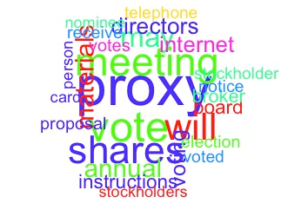
Wordcloud
It’s evident from the Wordcloud that “Proxy” is the most frequently occurring term in all the filings.
“Vote”, “Meeting” and “Shares” are the next predominant set of words that occur in the Question and Answer section.
Notes:
We have created a wordcloud from the combined Question and Answer sections collected over the 10 years based on the high frequency words using the worldcloud function in R.
Its evident from the world cloud that the most frequently occurring “word” is proxy that has appeared 557 times in the filing document followed by “vote” which occurred 408 times, “meeting” 383 times and “shares” 363 times.

Slide 11
Top 4 High Frequency Words
Proxy – These are documents that are used to inform shareholders and solicit votes for corporate decisions, such as the election of directors and other corporate actions.
Vote – Electing Nominees and making decisions on proposals outlined in the proxy statement.
Meeting - Discussions that take place regarding the company's progress on a yearly basis with the board of directors and stakeholders.
Shares - It is used in the filing document to highlight the volume each board of director owns and also with the bonus each individual gets for the upcoming financial year.
Notes:
“Proxy” is the most dominant word because the whole DEF 14a filing is nothing but the proxy statements. These statements consists of all the stock details, award details, salary that are presented to the shareholders who solicit their vote and draw up major company decisions.
“Vote” is the next predominant word as there were a lot of CEO Changes over the years 2006,2007,2013,2015 there were lot of voting procedure held to elect new CEO.
“Meeting” is another most occurring word as there were meetings held every year to discuss company progress and take up important decisions.
“Shares” highlights the volume each board of director owns and also with the bonus each individual gets for the upcoming financial year.

Slide 12
Word Association
The word “awards” is strongly correlated with the words mentioned below:
Code to find word association: findAssocs(x=QA_Corpus_1,term="awards",corlimit=0.99)
Positive Word Association
Negative Word Association
annually | vote | deemed | encourage | benefits | relations
0.99 | 0.99 | 0.99 | 0.99 | 0.99 | 0.99
abstain | withheld | unsecured | termination | risk
0.99 | 0.99 | 0.94 | 1.00 | 0.98
Notes:
One of the text mining features in R, is the findAssoc function, where it can be used to find words which associate together.
For Example, in our analysis we found the associated words for the term ‘awards’ using the findAssoc function. We also specify the correlation limit which is a value between 0 and 1 and 0.99 indicates that only the words that are strongly associated with the term “awards” will be listed.
We came with a list of POSITIVE words and a negative words that closely associate with term “awards”.
For instance , We have the word “annualy” it can closely associated with awards, since stock awards and options are given annualy.
On the negative side, we have withheld, where it could appear in a context where stockholders awards are withheld.

Slide 13
Key Event Indicator (KEI)
The variation in frequency is correlated to the changes in organization in 2007, 2008, 2013 and 2015.
Vote
Resign
2006 | 2007 | 2008 | 2009 | 2010 | 2011 | 2012 | 2013 | 2014 | 2015
25 | 22 | 23 | 31 | 33 | 25 | 45 | 48 | 34 | 39
2006 | 2007 | 2008 | 2009 | 2010 | 2011 | 2012 | 2013 | 2014 | 2015
10 | 12 | 14 | 14 | 14 | 14 | 14 | 17 | 14 | 20
Notes:
Another KEI that we came across in the analysis of the Question and Answer section, where we chose one of the highest frequency words ‘vote’ and a negative word ‘resign’.
The table represents the years and the number of times the words have appeared in the Question and Answer section.
We found both these words Co-Related with the changes that occurred over the years in the organization.
First we have vote, where we see spike in the number of occurrences going from 2011 to 2012 increasing from 25 to 45.
So this change attribute to the fact that there were new proposals made to improve the company’s performance or elect a new CEO which did happen in 2013.
Then we have resign, where the change in frequencies coincided with new CEO’s taking office.

Slide 14
Conclusion
Salary Trends and Stock option awards of CEO’s was at its lowest in 2013
Performance and rating improved in 2014 and 2015.
High Frequency Words: proxy, vote, share, meeting
KEI: vote and resign
Notes:
To conclude and summarize our analysis, we first saw that the salary trends and stock option awards of the CEO’s of Electronic Arts dropped drastically in the year 2013.
With the inception of the new CEO taking office from 2014 onwards, the organization saw significant rise in revenue and stock options.
Coming to the text mining part we found that the highest frequency words in the Question and Answer section were: proxy, vote, share, meeting
The KEI which we analyzed for the words vote and resign, correlated to change in CEO’s over the course of ten years from 2006 to 2015.

Slide 15
THANK YOU

